Slide 1
Computational Physics
(Lecture 11)
PHY4061

Slide 2
Discusssion
The choice of lattice point i: could be different.
Two common approaches are: choose the point following the order of lattice index or randomly choose the point.
To randomly choose i, we have to make sure that each lattice point is visited for the same number of times.
Each Monte Carlo Step (MCS) is that we visit each point once.
Thousands or millions of steps will be performed in this calculation.
Since there exists only one spin flip between the current state and the previous state, the physical properties are highly correlated. Therefore, we don’t have to calculate the physical quantities for each step.
Energy difference calculation is time consuming. To Ising model, the energy difference can be only a few values. We can calculate them before the simulation and store them. This is a typical strategy for many MC calculations.

Slide 3
Simulation Details
To simulate Ising models
First step is to choose a lattice.
  For example, we can us SC, FCC, BCC….
The simulation cell can be cubic like or other shape. To apply PBC, we need to make sure that the simulation cell can fully occupy the whole space without overlapping.

Slide 4
Details of the simulation
Some typical numbers:
To equilibrium: 5x10³---5x10⁵ MCS.
For average value calculations: 10³ ---10⁸ MCS.
Ising lattice: L=10—500.
No of particles: N=10²---10⁸.

Slide 5
Details of the simulation
Initial configuration
Under the critical temperature:
The equilibrium configuration is ordered. If we start from random configurations, there could be ordered grains with grain boundaries. It is difficult to eliminate the grain boundaries.
If we want to study the grain boundaries, then we have to start from random configurations.
Above the critical temperature, either way will be fine.

Slide 6
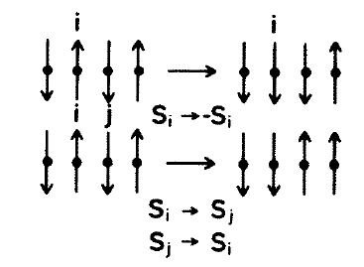
Details of the simulation
How to build the Markov chain.
Generally speaking, each state and its previous state in the Markov chain should be similar. If the difference is large, the energy difference can also be huge. The transition probability can be too small. The calculation will stick to some small subspace in the phase space.
Two options: change one spin at a time. Or change the spin of a pair that has opposite spins at the same time to preserve the total spin.

Slide 7
Details of the simulation
The choice of lattice point to flip.
Two choices: follow the lattice index order or randomly choose the lattice point.
To a N=LxLxL lattice, we can define N times of flips as a MCS.

Slide 8
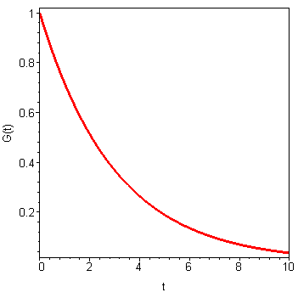
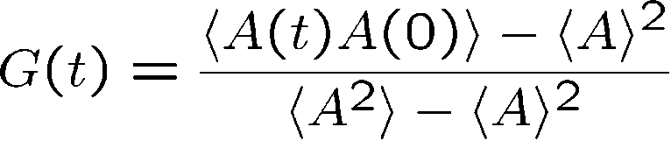
Simulation details
Discussion
We don’t have to calculate the physical properties after each MCS since they are highly correlated.
To determine how many steps for each calculation, we need to calculate the autocorrelation function:
For large time separations, the autocorrelation function decays exponentially.
The correlation length can be defined as:
  ξ= -lim |x|/ln G(x), when |x| goes to infinity.

Slide 9
Pre-calculating the energy differences.
How many configurations for Cubic lattice when we flip the spin of one lattice site?

Slide 10
Simulation Details
One example, For 2D simple cubic Ising model, Each spin(s₀)has 4 neighbors, s₁, s₂, s₃, s₄, The interaction energy of s₀ and its neighbors:
Flip the spin (s₀) the possible energy difference:
So
Calculate δ E₀ and e^{-βδ E0}, store each value onto a table, we may save a lot of
computational time.

Slide 11
Phase Transition
Region in between the extremes, where strong cooperation effects may cause phase transitions
  From an ordered phase at low temperature to a disordered phase at high temperatures.
Most challenging task in statistical mechanics and numerical simulations.

Slide 12
First order
Most phase transitions in nature.
Field-driven transition in magnets at temperatures below the Curie point.
Ordinary melting.
Characterized by discontinuities of the order parameter.
  For example, the jump of delta m of magnetization.
  Latent heat delta e, or by both.

Slide 13
At transition temperature, two or more phases can coexist.
  At melting point, ordered and disordered phases can coexist.
Singularity associated with the jumps of e or m.

Slide 14
Second order phase transition
Characterized by a divergent correlation length ξ at the transition temperature.
From high temperature:
  ξ= ξ₍₀₊₎|1-T/Tc| ^{-γ}+ correction term (T>=Tc)
From low temperature:
  ξ= ξ ₍₀₋₎|1-T/Tc| ^{(-γ)}+ correction term (T<=Tc)
For C, m, they all follow the similar power law kind of descriptions.

Slide 15
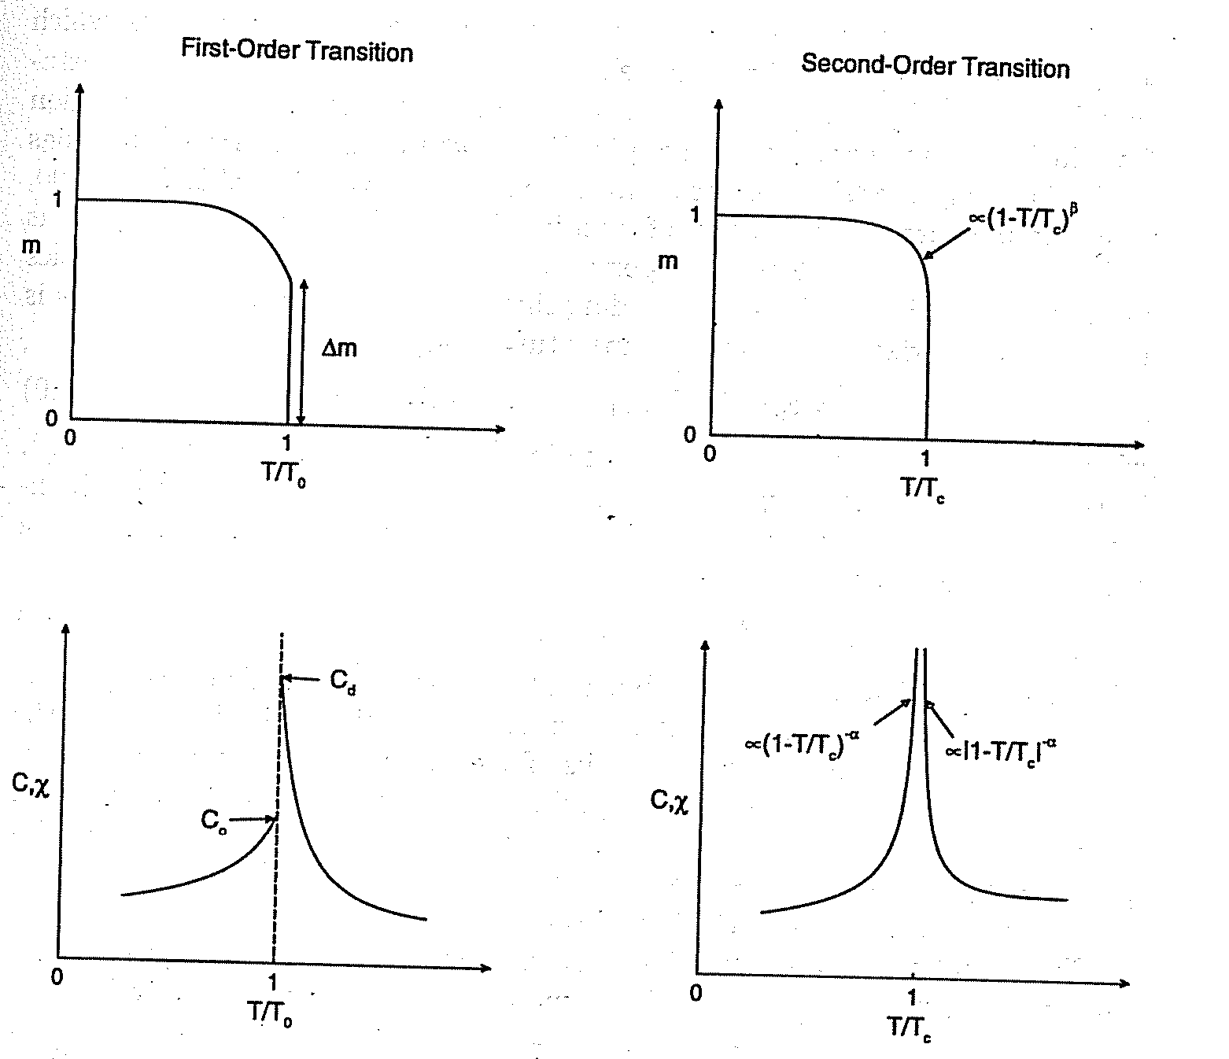

Slide 16
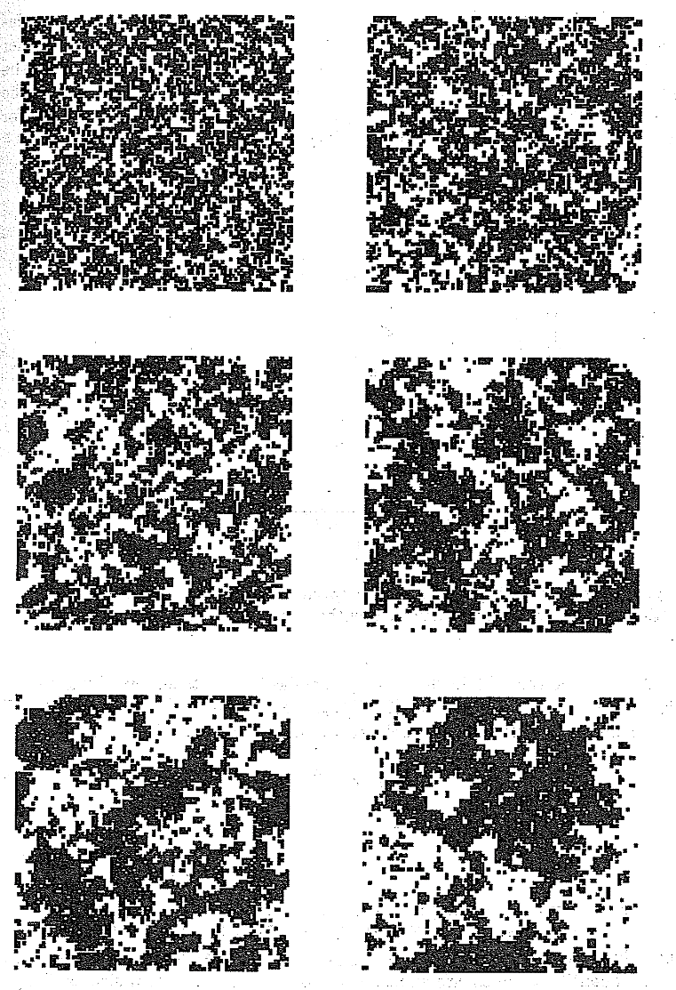
The growth of correlations from high temperatures to the critical region.

Slide 17
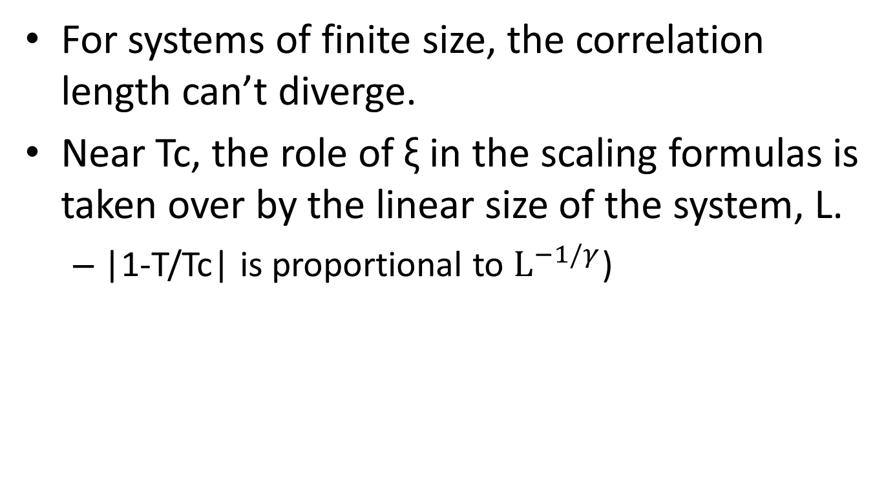
Finite Size Scaling
For systems of finite size, the correlation length can’t diverge.
Near Tc, the role of ξ in the scaling formulas is taken over by the linear size of the system, L.
  |1-T/Tc| is proportional to $L^{−1/γ}$)

Slide 18
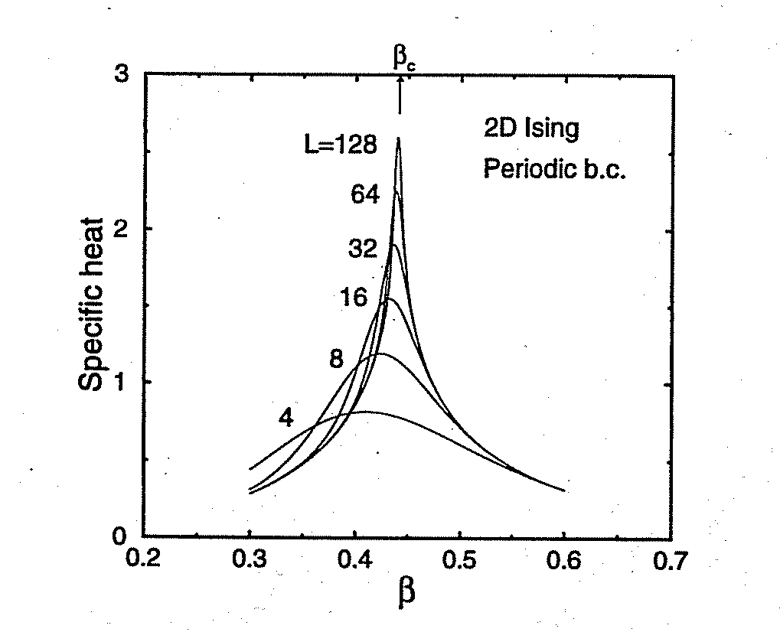

Slide 19
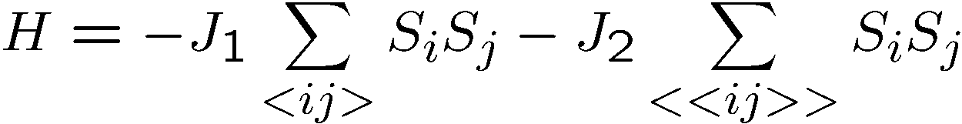
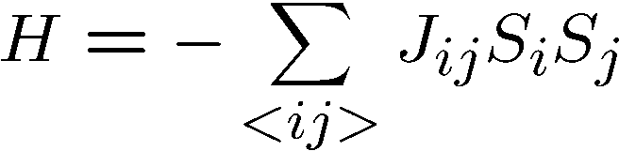
Some other interesting models:
Second nearest neighbor model:
Spin glass model
J_{ij} are random

Slide 20
More discussions
Advantages of Metropolis algorithm
Flexible. It can be extended to many physical systems.
Disadvantage of Metropolis algorithm
Large auto correlation time, as most local update algorithms.

Slide 21
At very high temperature, almost all the spins are uncorrelated.
Therefore flipping of a spin : high chance of being accepted into the new configuration.
When the system is moved toward the critical temperature from above,
domains with lower energy start to form.
Suppose the interaction is ferromagnetic.
Large clusters with all the spins pointing in the same direction.
If only one spin is flipped, the configuration becomes much less favorable because of the increase in energy!

Slide 22
Critical Slowing down
The favorable configurations:
  ones with all the spins in the domain reversed,
  a point that it will take a very long time to reach!
We need to have all the spins in the domain flipped.
  This requires a very long sequence of accepted moves.
  This is known as the critical slowing down.

Slide 23
Empirically, autocorrelation time grows proportional to the power of correlation Length. In the case of MC, t_{c} =c L^{z}.
Here, z is about 2.
The Swendsen and Wang approach (1987).
  The block update scheme: based on the nearest neighbor pair picture of the Ising model
  the partition function is a result of the contributions of all the nearest pairs of sites in the system.

Slide 24
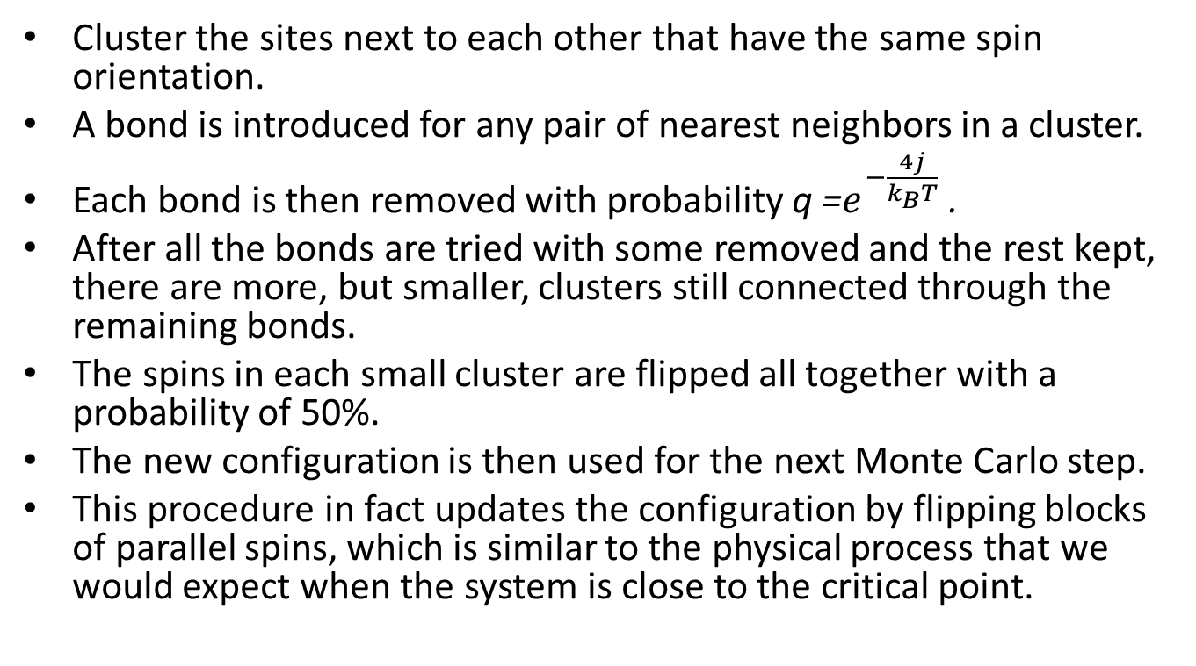
Summary of the algorithm
Cluster the sites next to each other that have the same spin orientation.
A bond is introduced for any pair of nearest neighbors in a cluster.
Each bond is then removed with probability q =$e^{−\frac{4j}{k_{B}T}}$ .
After all the bonds are tried with some removed and the rest kept, there are more, but smaller, clusters still connected through the remaining bonds.
The spins in each small cluster are flipped all together with a probability of 50%.
The new configuration is then used for the next Monte Carlo step.
This procedure in fact updates the configuration by flipping blocks of parallel spins, which is similar to the physical process that we would expect when the system is close to the critical point.

Slide 25
The speedup in this block algorithm is extremely significant.
Numerical simulations show that the dynamical critical exponent is significantly reduced, with z =0.35 for the two-dimensional Ising model and z =0.53 for the three dimensional
Ising model, instead of z = 2 in the spin-by-spin update scheme.

Slide 26
Wolff Algorithm
S-W does not eliminate the critical slowing down completely.
Wolff Algorithm, greatly improve the 3D Ising model. In 4D, z is approaching to 0!

Slide 27
Instead of removing bonds, Wolff proposed constructing a cluster in which the nearest sites have the same spin orientation.
Select a site randomly from the system and add its nearest neighbors with the same spin orientation to the cluster with the probability p = 1 − q.
All the spins in the constructed cluster are then flipped together to reach a new spin configuration of the system.

Slide 28
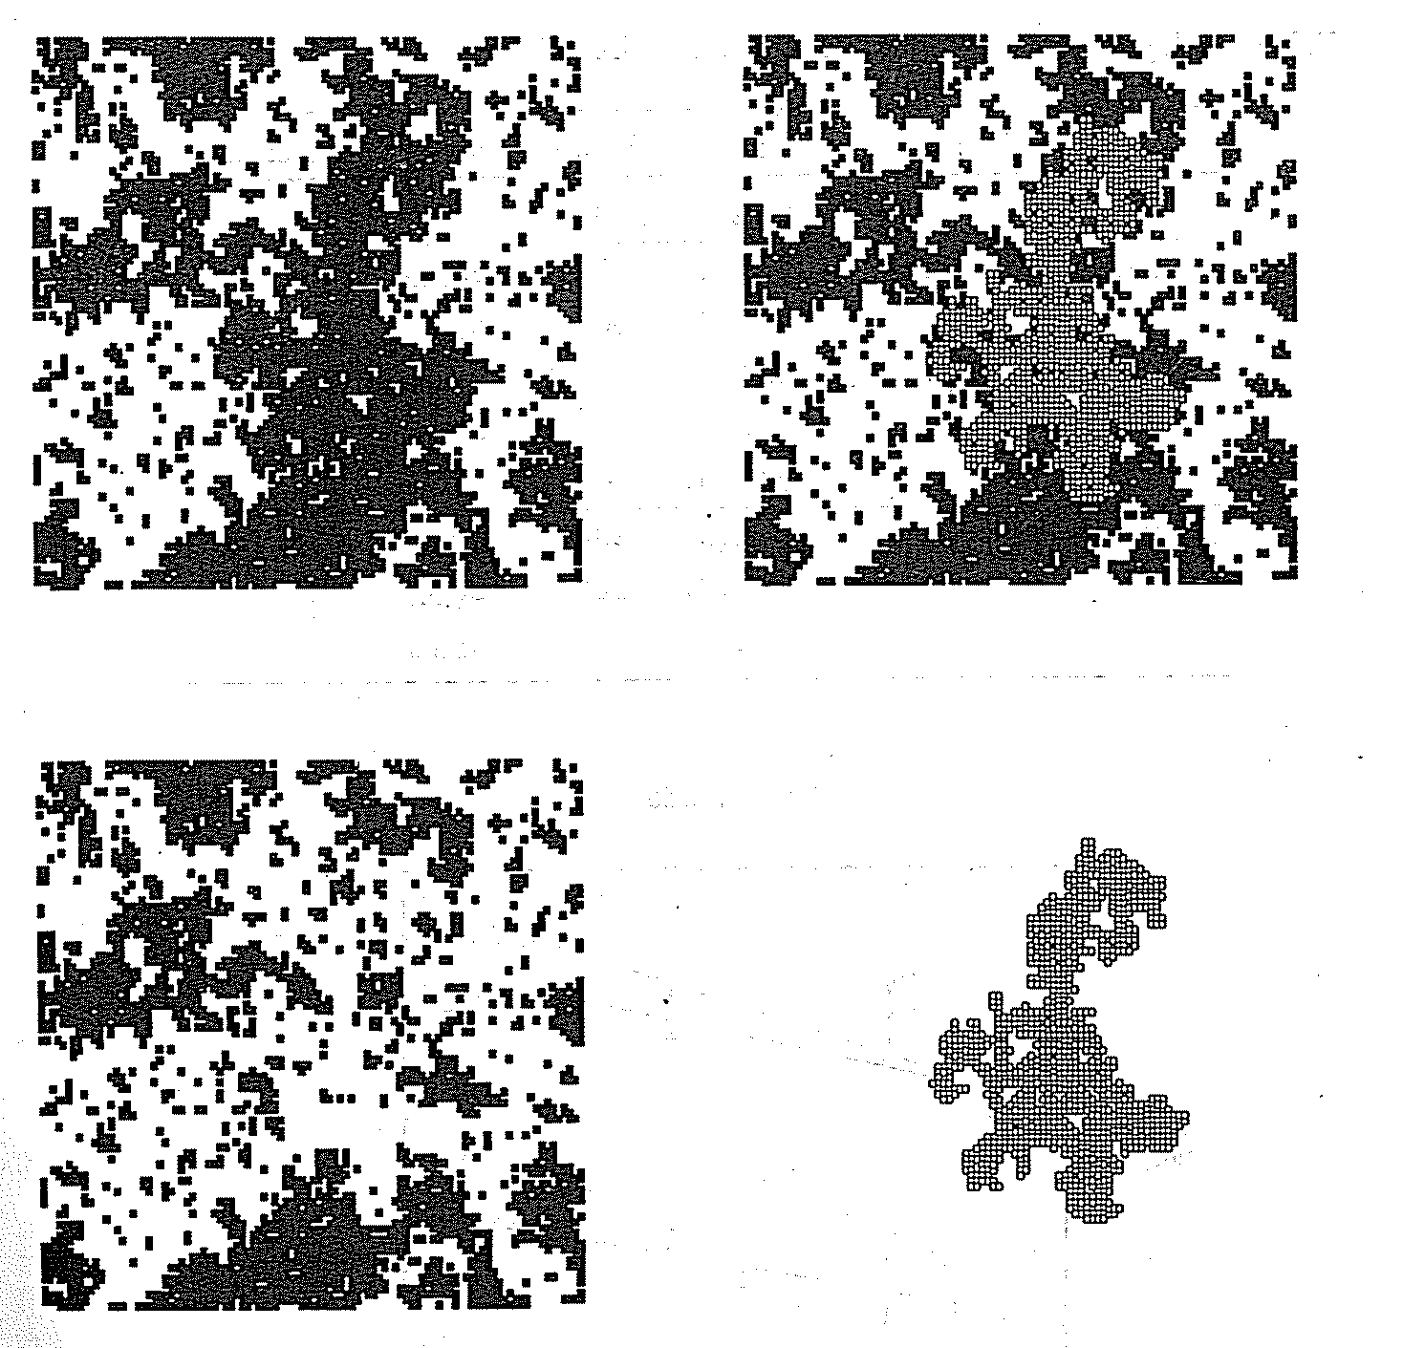

Slide 29
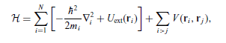
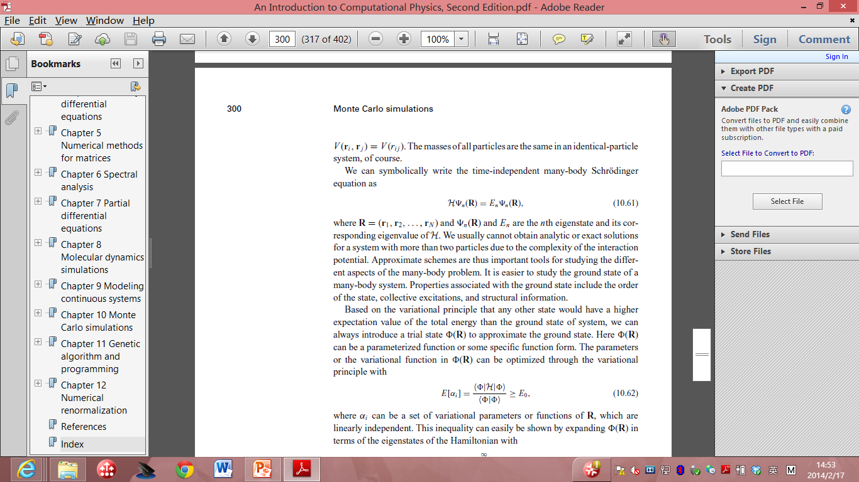
Variation quantum Monte Carlo
the approximate solution of the Hamiltonian
Time Independent many-body Schrodinger’s equation:

Slide 30
We cannot obtain analytic or exact solutions for a system with more than two particles due to the complexity of the interaction potential.
Approximation is important.
One of the most important problems:
  Ground state properties.

Slide 31
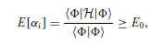
Based on the variational principle
  introduce a trial state φ(R) to approximate the ground state.
Here φ(R) can be a parameterized function or some specific function form.
The parameters or the variational function in φ(R) can be optimized through the variational
principle with
α_{i} : parameters or
functions of R

Slide 32
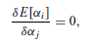
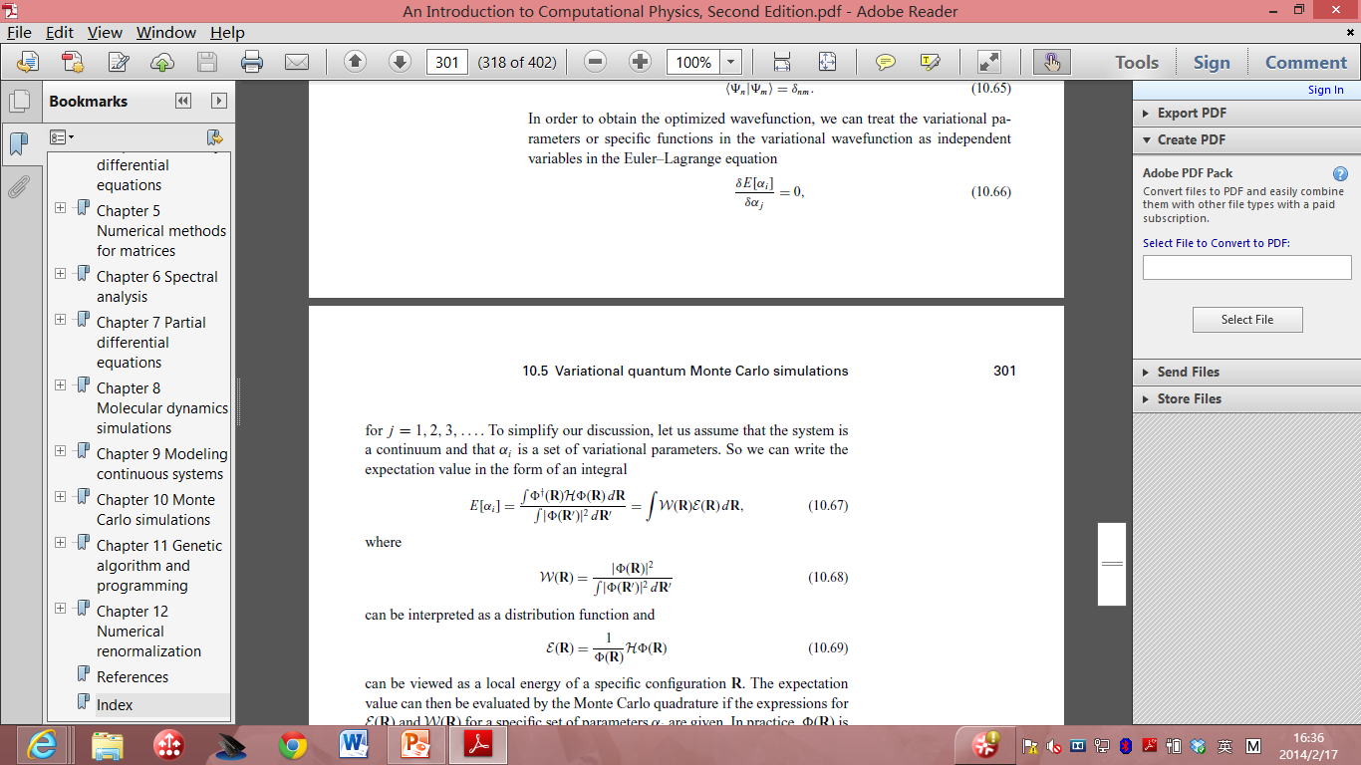
Treat the α_{i} as independent variables in Euler_Lagrange equation:
Distribution function, sample it.
Evaluate E as the average of Local energy of the configuration R

Slide 33
The expectation value of energy can be evaluated using MC if we have the forms of both functions.
Important to include physics in φ(R) , then take the variation process.

Slide 34
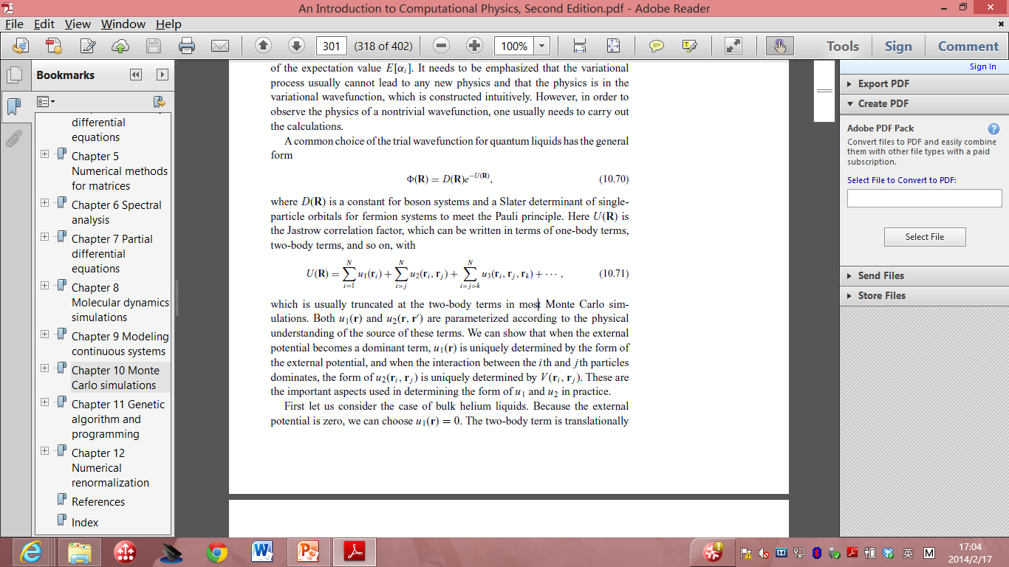
For quantum liquids:
D(R): a constant for boson systems and a Slater determinant of single particle orbitals for fermion systems to meet the Pauli principle.
Here U(R) is the Jastrow correlation factor, which can be written in terms of one-body terms, two-body terms, and so on, with

Slide 35
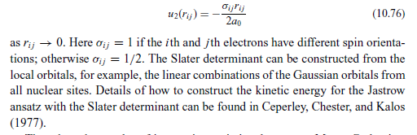
The electronic systems.
  Atomic, molecular and solids system.
  u₁(r)= Z r/a₀ (a₀ is the Bohr radius)

Slide 36
for the statistical system the calculations are done for a given temperature, but for the quantum system they are done for a given set of variational parameters in the variational wavefunction.
We can update either the whole configuration or just the coordinates associated with a particular particle at each Metropolis step.

